Slide 1

Process Mining Virtual Internship
by
U Naga Harsha Sree
Roll No. 224G1A3359
Department of Computer Science and Engineering (AI & ML)
Srinivasa Ramanujan Institute of Technology
(Affiliated to JNTUA & Approved by AICTE) (Accredited by NAAC with ‘A’ Grade & Accredited by NBA (EEE, ECE & CSE)
Rotarypuram Village, B K Samudram Mandal, Ananthapuramu – 515701.
2024 - 2025

Slide 2
Contents
Course Objective
Introduction
Technology
Applications
Modules
Real Time applications
Learning outcomes
GitHub Link
Queries

Slide 3
Course Objective
Process mining involves how to analyze and improve business processes using data driven techniques.
To extract insights from event logs, identify bottlenecks, optimize processes and enhance overall efficiency
Understand the phases of process mining analysis.

Slide 4
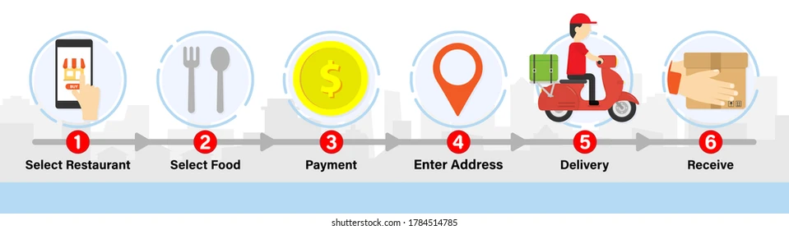
Introduction
Process
Process refer to series of activities or steps perform to achieve a specific goal.
The purpose of process is to establish and maintain flow that allows a task to be completed.

Slide 5
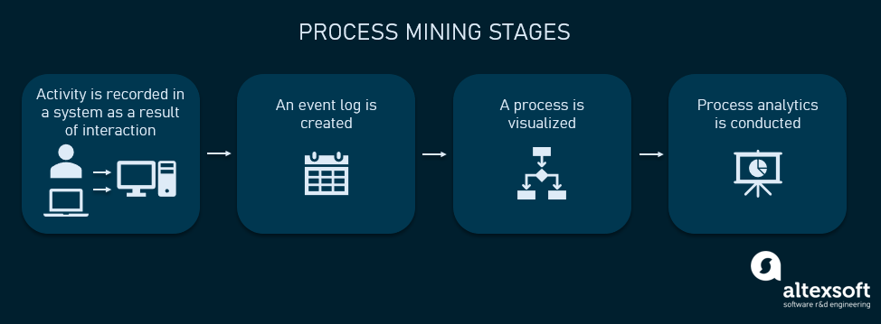
Introduction
Process Mining
Process Mining is a method that involves extracting data from event logs to analyze and improve processes within an organization
By analyzing event data process mining can identify bottlenecks, inefficiencies and deviations from desired process flow.
It uses algorithms and visualization techniques to discover, monitor,and enhance process performance.

Slide 6
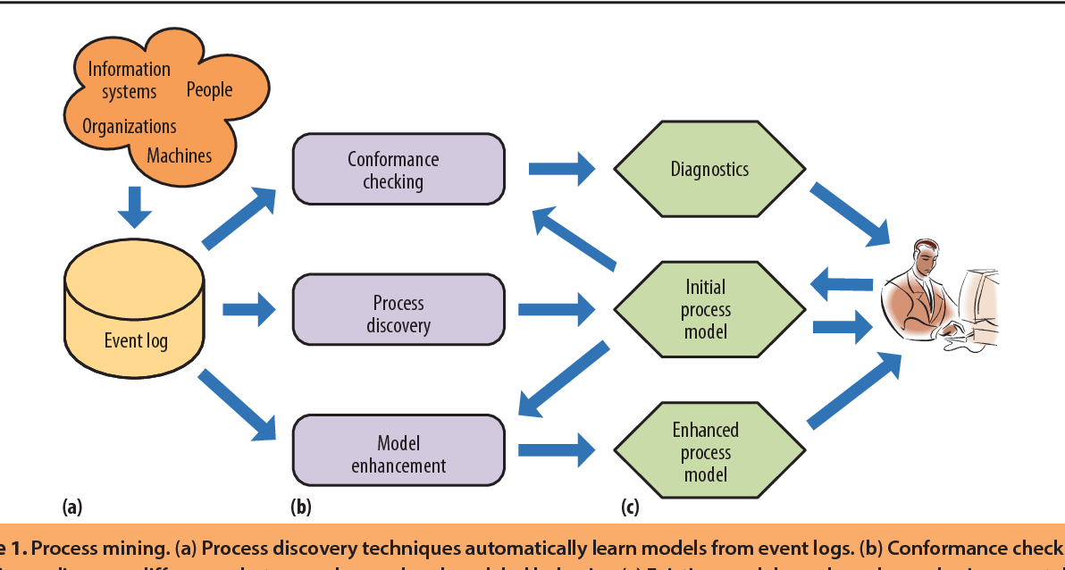
Technology
There are three main groups in process mining techniques
Process discovery
Conformance checking
Analysis & Enhancement

Slide 7
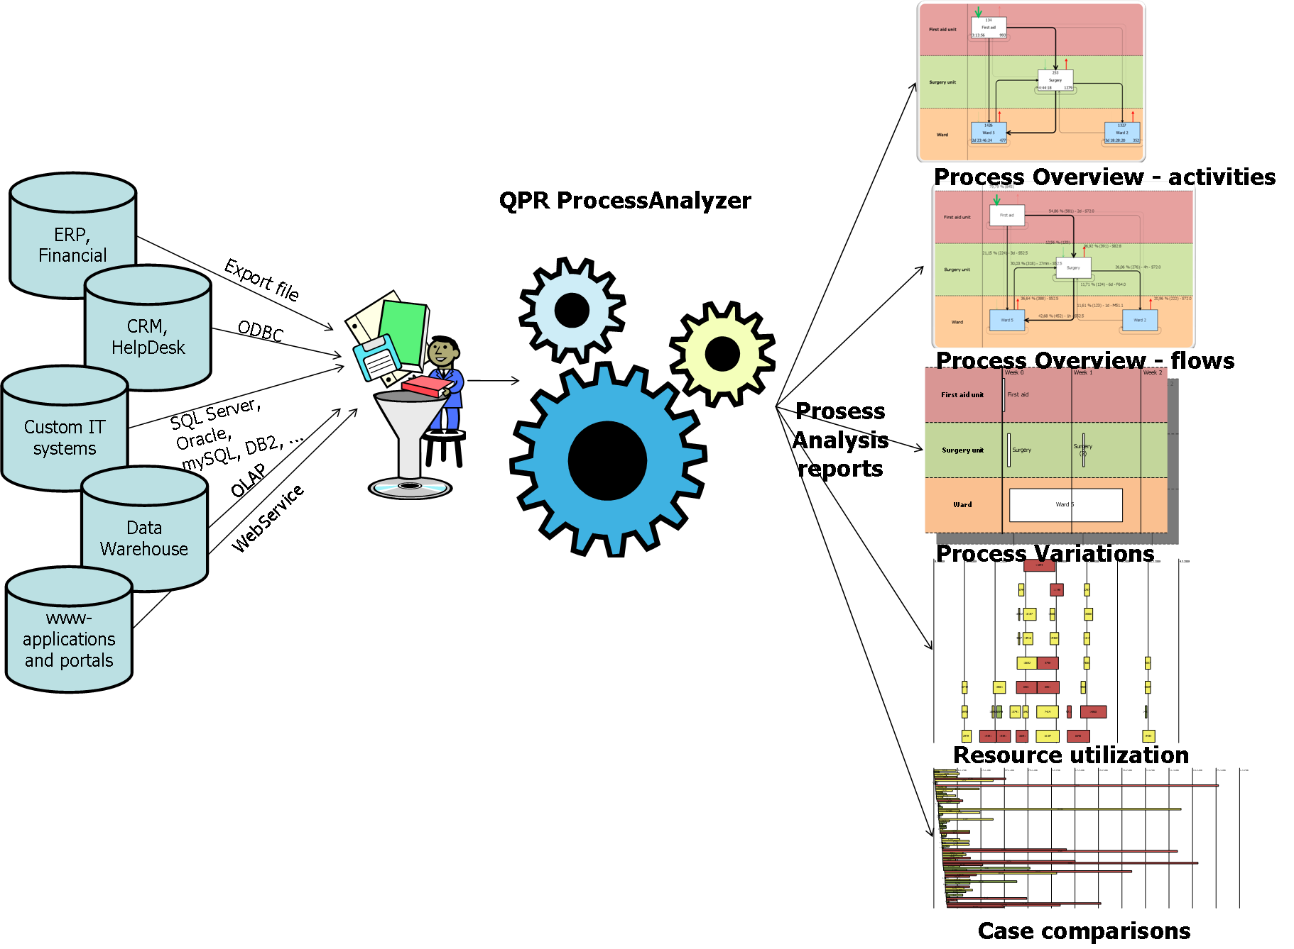
Techology
1. Process Discovery
It create a visual representation of process model based on event data.
During discovery ,process mining software traces the entire business workflow
Process discovery algorthims uses various approaches such as alpha, heuristic.

Slide 8
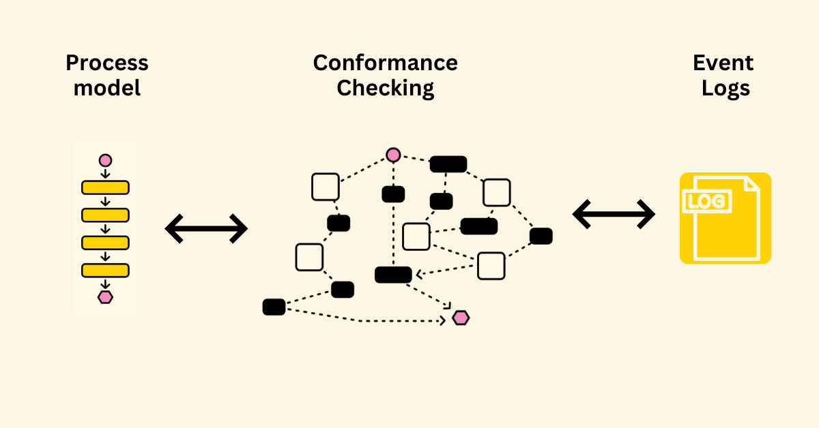
Technology
2. Conformance check
It is a technique used to compare a reference process model with actual process flow discovered from the data.
It is used to check actual execution of a business process, as recorded in the event log, conforms to model and vice versa

Slide 9
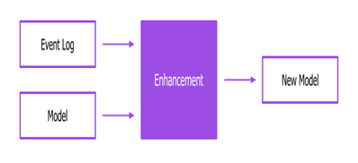
Technology
3. Analysis and Enhancement
It focus on extending the model with additional information such as location data, costs, timings etc.
It is used to improve an existing process model based on event logs.
This involves identifying bottlenecks, inefficiencies for automation

Slide 10
Applications
Customer journey analysis
process mining can provide insights into customer interactions with business process and share experience, helps to build strong relationships.
Healthcare Process Analysis
process mining can improve patient care and resource allocation
Fraud Detection
process mining can identify unusual patterns of behaviour that might indicate fraud activities
Risk Management
process mining can help to identify and mitigate potential risk in processes

Slide 11
Modules
Introduction to process Mining
Process Mining fundamentals
Joins & Filters

Slide 12
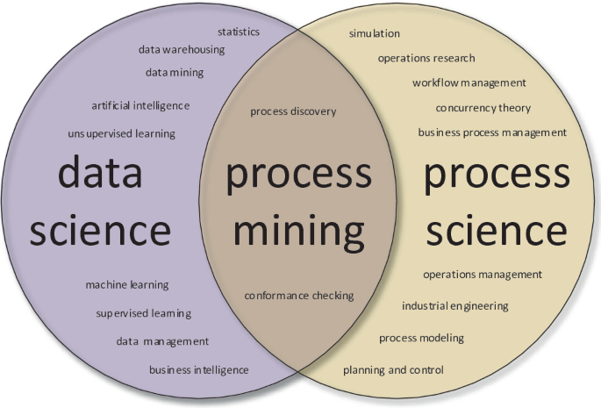
Introduction to Process Mining
Process Mining is the combination of two disciplines: Data Science and Business Process Management.
Process mining use Data Science techniques, such as big data and AI to address process science problems such as process improvement
Process Mining achieves the union by taking digital footprints that are created by IT systems and using them to reconstruct and visualize process flow

Slide 13

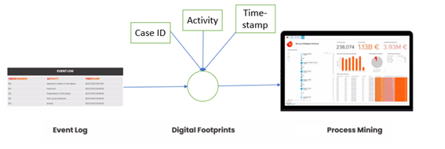
Introduction to Process Mining
Digital footprints
A digital footprint is the information and data trail that is left behind when we use internet.
Ex: online activities such as web sites
Data always contains three piece of information
It include information about activities performed, timestamp, id or user interactions and other relevant data

Slide 14
Process Mining Fundamentals
Process Mining works by extracting knowledge from event logs (also called digital footprints) readily available in today’s information systems, to visualize business processes and their every variation as they run.
Exploratory Approach: An exploratory approach is one where you simply explore the data and see what value opportunities jump out at you. You are diving into the data without specific expectations and with an open mind. Analysis tools such as the Process Explorer, the Variant Explorer, and the Conformance checker are ideal for this.
Confirmatory Approach: With the confirmatory approach, you are examining the data to see if it confirms or denies a hypothesis. Using your Celonis Analysis, specifically by filtering on attributes and using drilldown tables, you can find out whether the data confirms or denies that these perceived pain points exist and have a significant impact.

Slide 15
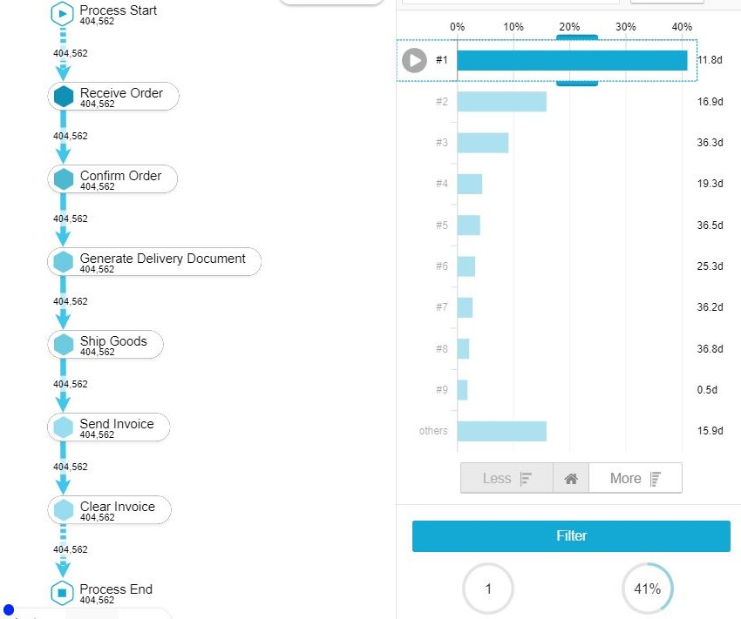
Process Mining Fundamentals
Variant explorer with single variant

Slide 16
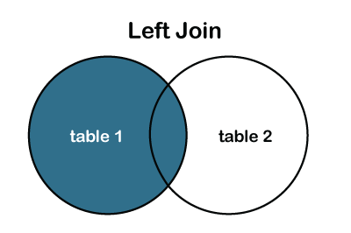
Joins and Filters
The table in data model are connected via specific relationships to associate rows of one table with rows of another table. This is done using foreign key.
In general relationships can be classified as
One-to-one or 1:1
One-to-many or 1:N
Many-to-many or N:M

Slide 17
Real Time Applications
E-commerce: Organization leaders in the e-commerce sector can boost their conversion rates by getting exclusive insights into buyer behavior, market trends, and growing customer base.
Healthcare: The healthcare industry has a surplus of data, from health records to appointment booking procedures. Professionals can reconstruct this data digitally with process mining software for seamless integration.
Education: Educational process mining (EPM) allows administrators to analyze and visualize students’ learning behavior by applying specialized algorithms. The student activity logs provide insights into tracking and monitoring their academic performance.
Finance: Automation and process enhancement significantly benefits the finance sector. Process mining can optimize audit controls, find root causes for incorrect invoices, mitigate risk, and enhance loan processes.
IT & software: IT professionals benefit from sorting out disorganized engineering processes by gaining clarity and managing the complexity of ERP migrations and implementation. They can also monitor systems in real-time to ensure everything is running smoothly.

Slide 18
Learning Outcomes
After completion of this training, we should be able to:
Understand what Process Mining is and the basics of how it works.
Applying process improvement techniques
To extract insights from event logs, identify bottlenecks, inefficiencies, and opportunities for optimization.

Slide 19
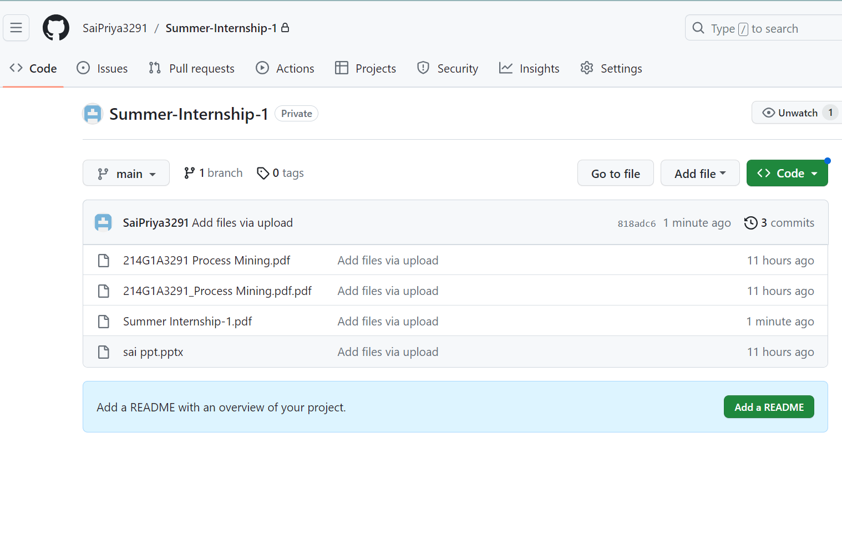
Git Hub Dashboard

Slide 20
Any Queries?

Slide 21
Thank You!!!

